Slide 1
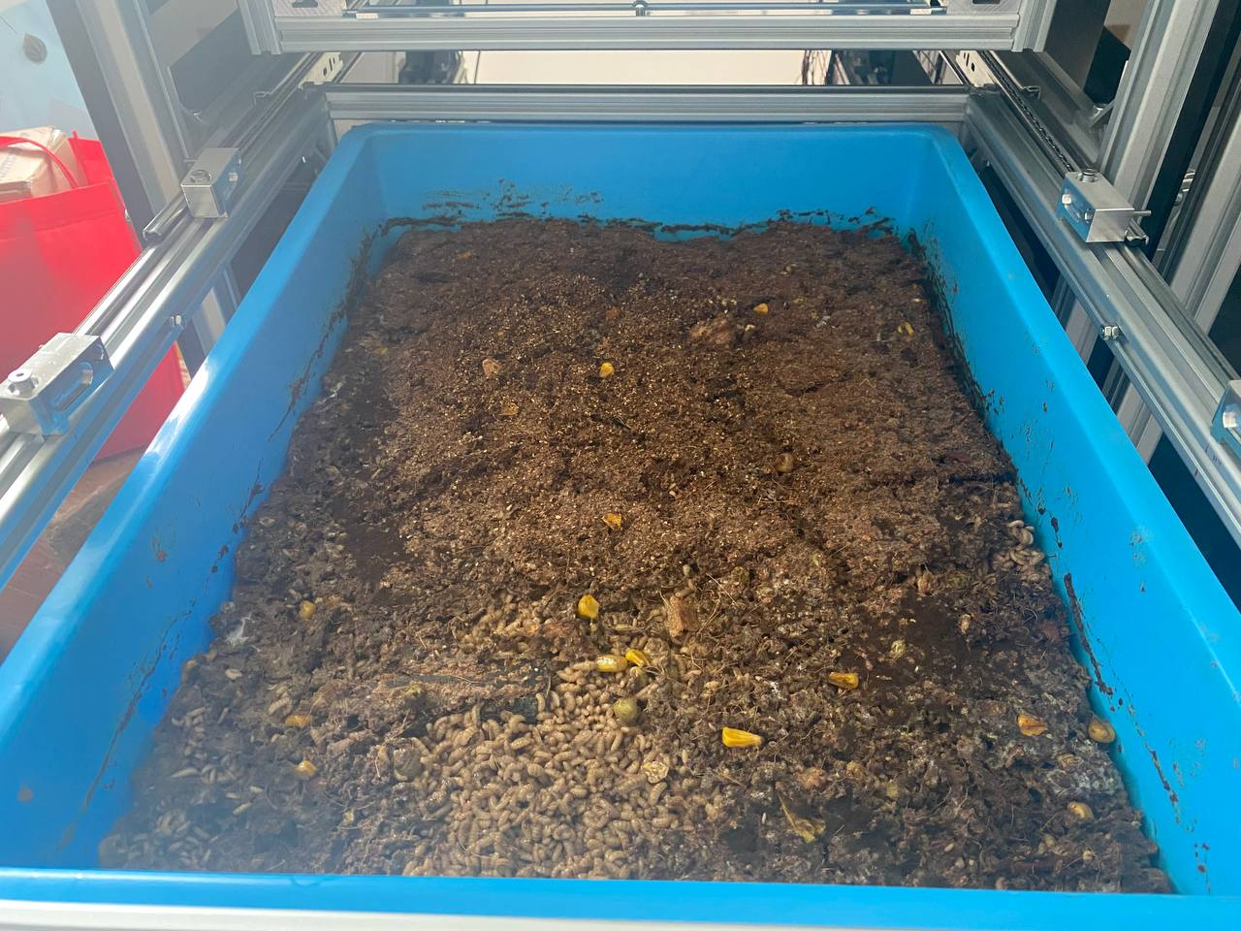
4th April to 8 April
Container #2
Experiment start: 6:51 pm (Thursday)
First Data Point measured is at: 7:01pm
Experiment stopped at about: 1:10 pm (Monday)

Slide 2
List of Parameters
Air Temperature (°C)
Temperature in Substrate (°C)
Relative Humidity (%)
Moisture Content (Only Middle Container, Top & Bottom Readings are invalid)
pH Value
Methane (ppm)

Slide 3
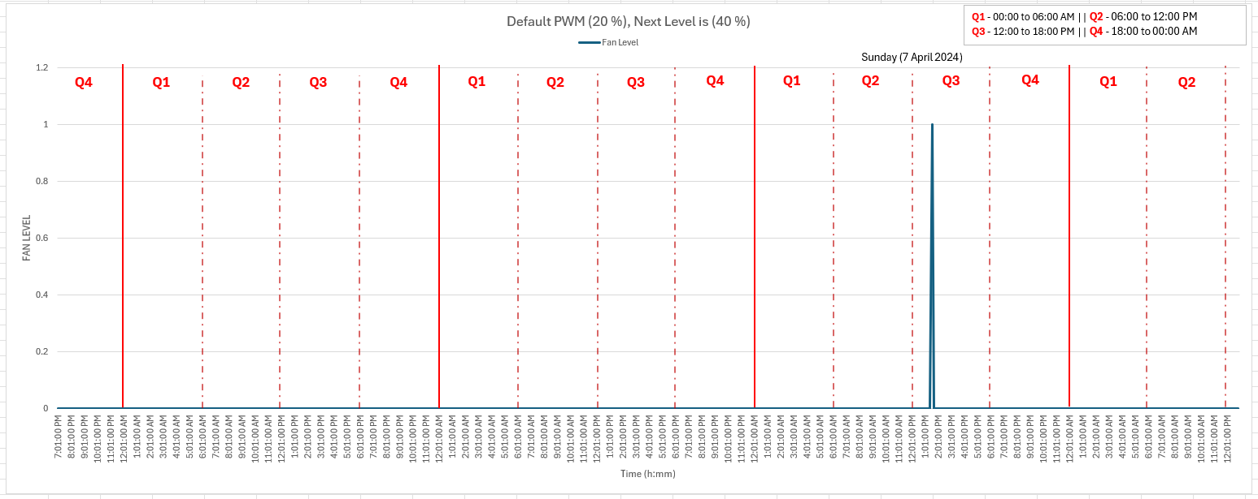
Fan Speed Increased to 40% on Sunday, Time: 1:31 pm

Slide 4
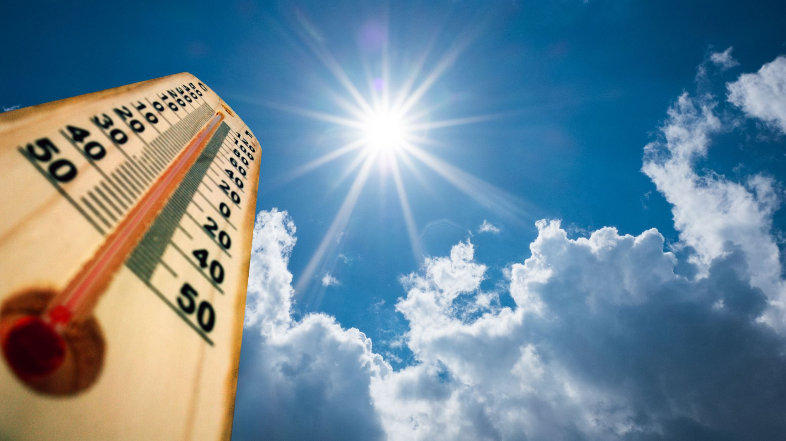
Air Temperature (°C)
Fan speed maintain at 20% PWM, except for one time on Sunday, temp exceeded Threshold of 33 °C

Slide 5
Readings at (Inlet) & (Outlet) does not appear to have large difference

Slide 6
Temperature in Substrate(°C)
Parameter did not exceed Threshold of 36 °C

Slide 7
Trend for Temp Readings in all 3 containers are same(?)
Temp in the Bottom Container (#1) is slightly higher than rest during the second, third and forth day.

Slide 8
Placed Both Temperature readings on the same Graph

Slide 9
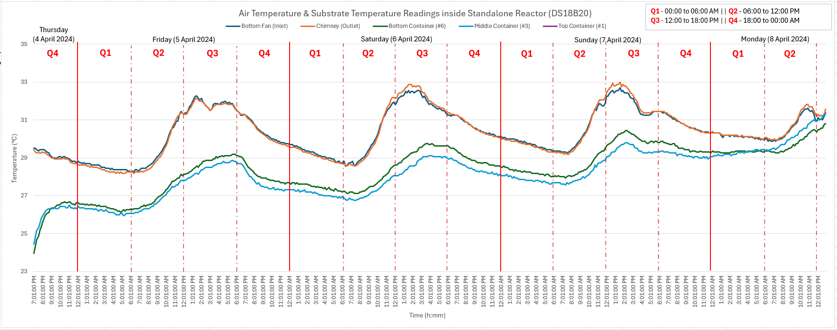
Temperature readings display a common pattern ?

Slide 10

Relative Humidity
Parameter did not drop below 40 %

Slide 11
Relative Humidity exhibits a decreasing trend.
(Enclosed with ventilation)
Relative Humidity is lowest when the Sun is at its peak.

Slide 12

Moisture Content

Slide 13
Moisture Content in Substrate slowly decreases
Moisture Readings for Bottom and Top Containers indicates dryer moisture level… Likely sensor not place deep enough or in a location that is not in good contact with substrate

Slide 14

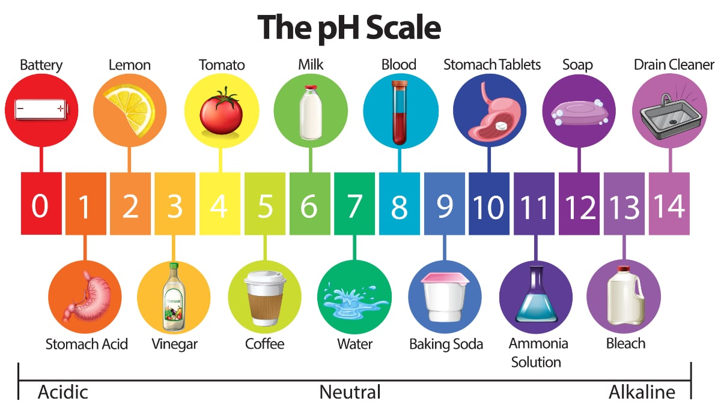
pH Value

Slide 15
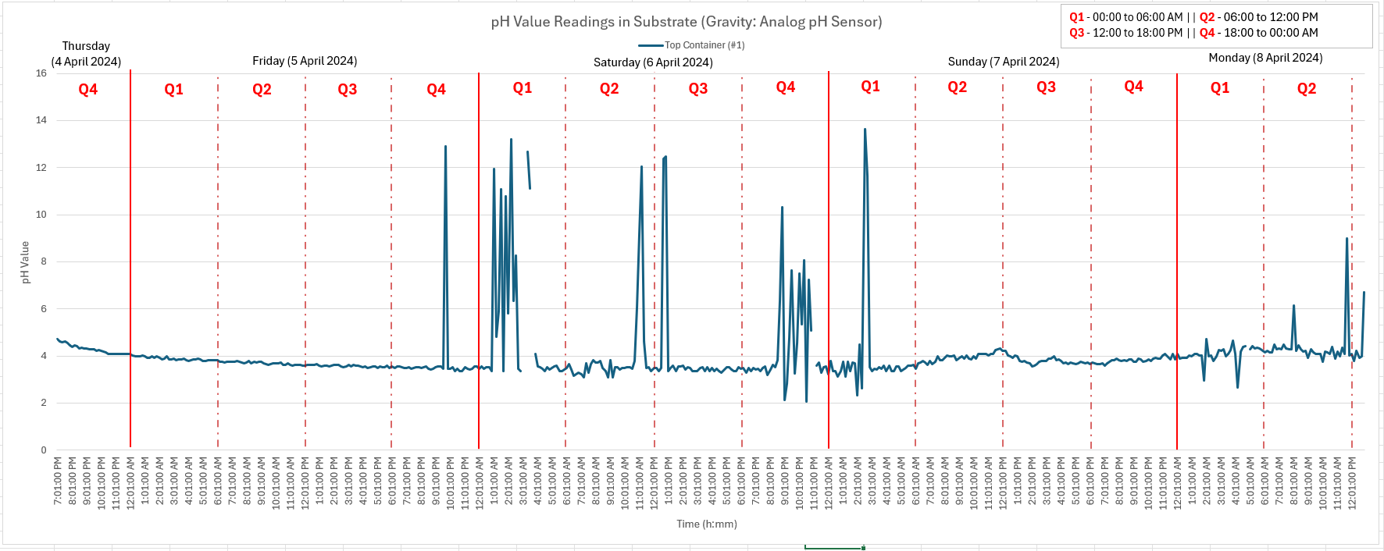
Not sure why the pH value is able to spike this large
pH value does not increase gradually like experiment in phase 1

Slide 16

Methane

Slide 17
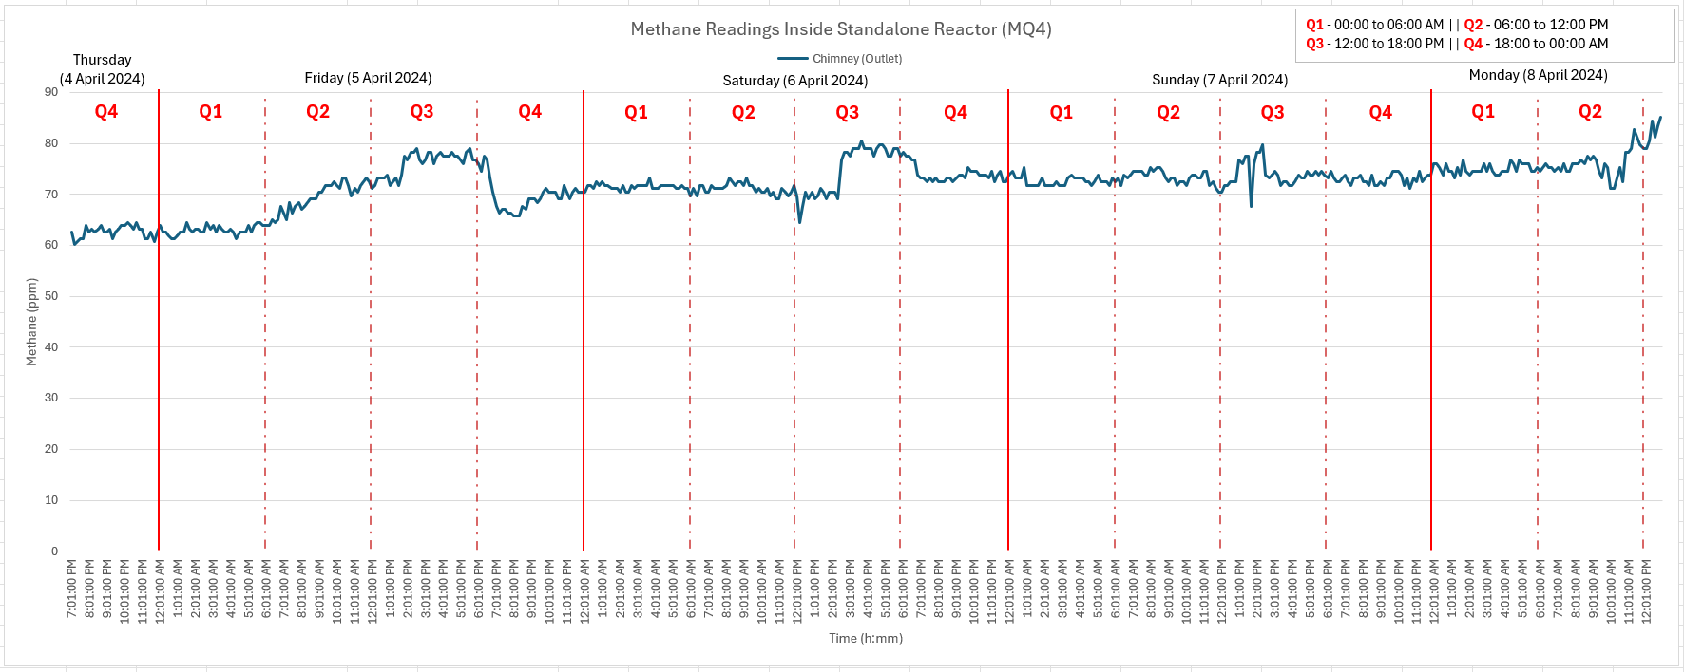
Methane reading has a positive upward trend (?)
Methane readings is highest after 12pm, evening (6pm) drops.
Except for 8-DOL (Sunday) and 9-DOL (Monday)

